Slide 1
NCAS, CEDA and JASMIN: AN OVERVIEW

Slide 2




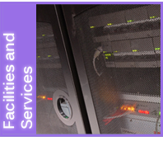
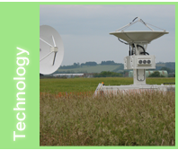
“National
capability”
Notes:
Ncas carries out research in
- The science of climate change, including modelling and predictions
- Atmospheric composition, including air quality
- Weather, including hazardous weather
- Technologies for observing and modelling the atmosphere
Plus national facilities to support atmospheric science for the whole of NERC and the wider academic community:
world-leading research aircraft, a ground-based instrumentation pool, access to computer models and facilities for storing and accessing data. This is “National Capability”.

Slide 3
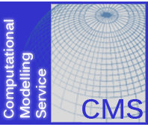


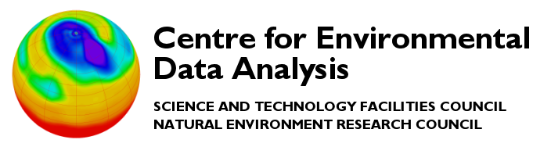


0

Slide 4
NCAS Computational Modelling Services (CMS)

Slide 5
NCAS Computational Modelling Services (CMS)
CMS staff undertake NCAS activities in support of computational science (particularly High Performance Computing (HPC) and numerical modelling)
Provide underpinning infrastructure for the UK academic atmospheric and polar science community to support climate, weather, and earth-system research.
Provide training for scientists:
NCAS Introduction to Scientific Computing course
NCAS Introduction to Unified Model course
NCAS CF Python tools course

Slide 6
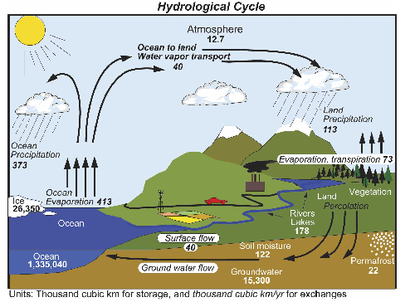
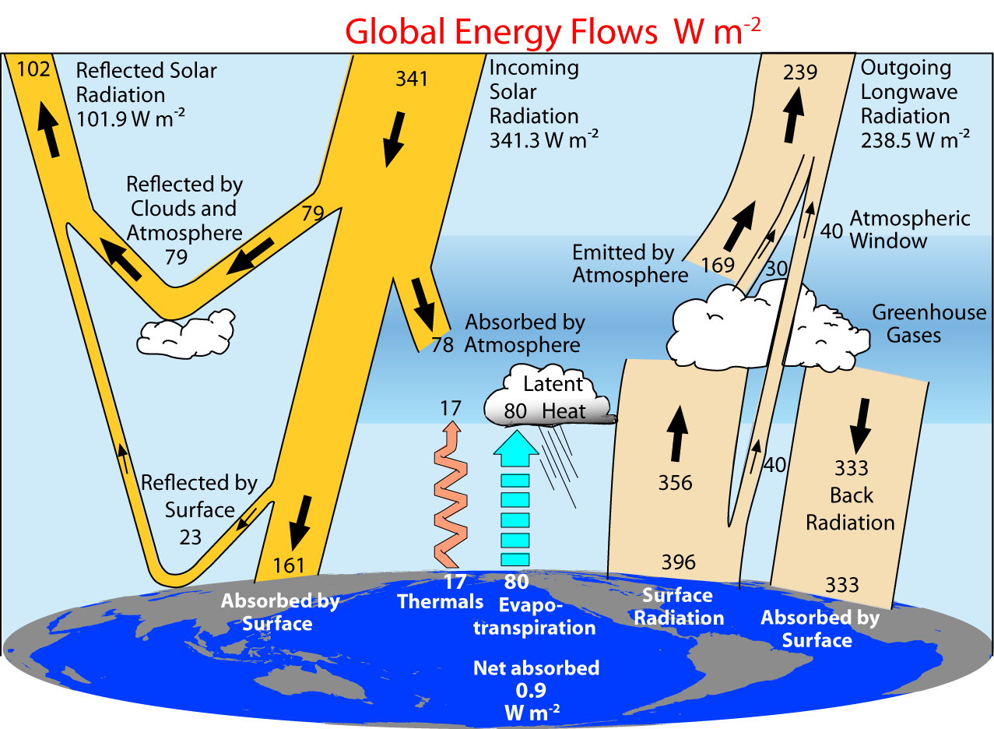
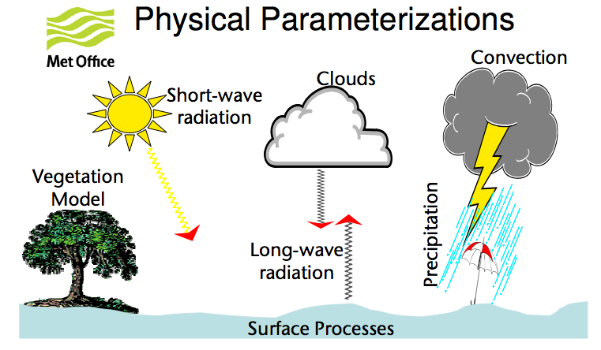
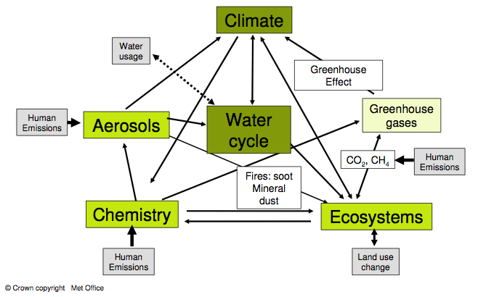
Climate Modelling
(Trenberth et al, 2007,2009)

Slide 7
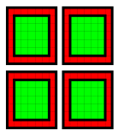
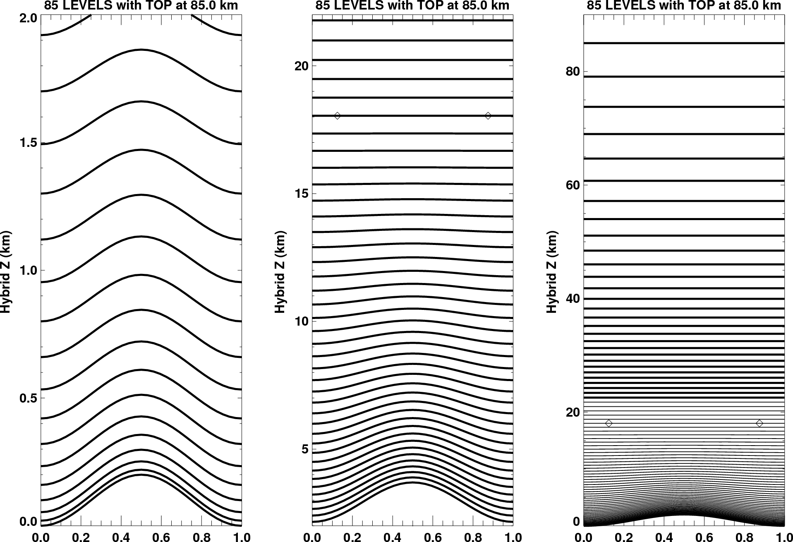
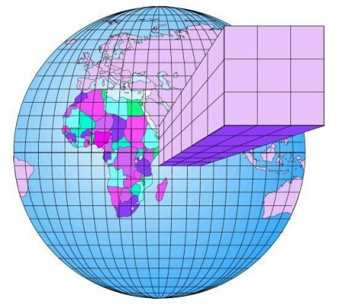


PARALLEL Implementation
Regular, Static, Lat-Long Decomposition
Mixed mode MPI/OpenMP
Asynchronous I/O servers
Communications on demand for advection
Multiple halo sizes
Land surface
Vertical resolution
Horizontal resolution

Slide 8
Global Models
N96 | N144 | N216 | N320 | N512 | N768 | N1024 | N2048
(192 x 145) | (288 x 217) | (432 x 325) | (640 x 481) | (1024 x 769) | (1536 x 1152) | (2048 x 1536) | (4096 x 3073)
~135 km | ~90 km | ~60 km | ~40 km | ~25 km | ~17 km | ~12 km | ~6 km
 | NWP | Climate
Run length | 10 day operational forecast, 15 day ensemble forecast | Months (seasonal) Years, decades, centuries+
Global resolution | Testing: N320 (40 km) with 15 min ts Operational: N768 (17 km) with 7.5 min ts | Low resolution: N96 (135 km) with 20 min ts High resolution: N512 (25 km) with 15 min ts
Dynamics | Non-bit reproducible | Bit-reproducible

Slide 9














NCAS supported MACHINES
PUMA
NOC
Code repositories
Clustervision
UM submission
Polaris
SGI
Lander
MONSooN
IBM Power 775
HPC Wales
Fujitsu
Cray XC30
MASS
Local
RDF
Jasmin
user ssh to all

Slide 10
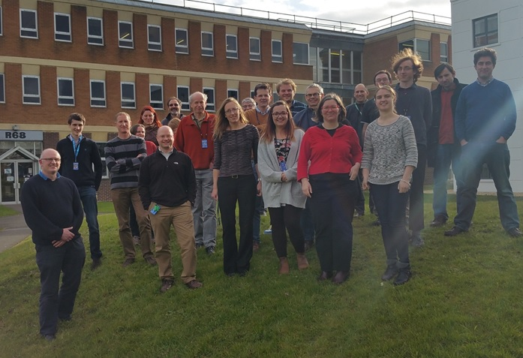

Slide 11






NERC Data Centres
NERC supports five data centres covering a range of discipline areas:
British Oceanographic Data Centre (Marine)
Centre for Environmental Data Analysis Archive (Atmospheric and Earth Observation)
Environmental Information Data Centre (Terrestrial and freshwater)
National Geoscience Data Centre (Geoscience)
Polar Data Centre (Polar and cryosphere)

Slide 12

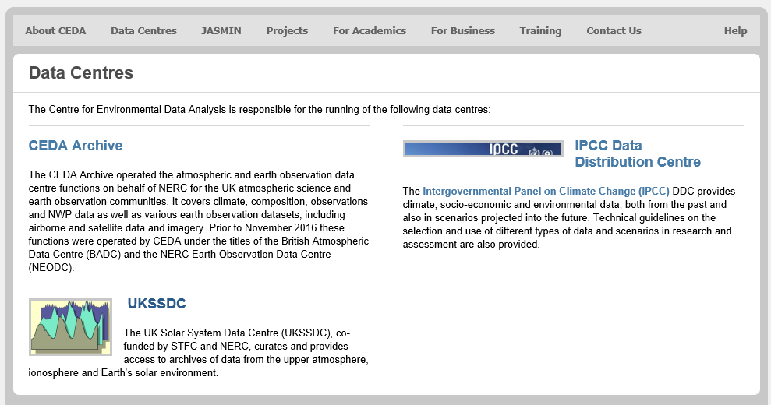
CEDA Data Centres
www.ceda.ac.uk
Notes:
We’ve seen that NERC has established a number of data centres and that their collective data holdings can be searched in a catalogue.
So what is CEDA and how does it fit into the NERC data centre organisation? The acronym CEDA stands for “Centre for Environmental Data Archival”. If you go to the CEDA home page at www.ceda.ac.uk and click on Data Centres in the top menu bar you will find a page showing a number of logos. Two of these we saw on our first slide, BADC and NEODC. There are two more: UKSSDC (UK Solar System data centre) collects data on solar-terrestrial physics; IPCC Data Distribution Centre exists to make climate prediction data from models available the climate impacts community (e.g. people studying effects of climate change on availability of fresh water). These last two are not funded in the same way as the NERC centres, nevertheless they archive data for their respective communities as do BADC and NEODC. Collectively, these four data centres have been given the umbrella title of CEDA.
The yellow boxes contain some CEDA facts and figures. The numbers are for 2013 and some may need a little updating but they will give you an idea of the quantity of data for which CEDA are responsible. For example we have 582 logical filesets (this means collections of data files that are related by some common factor, such as they were all funded by the same project or collected by the same instrument). These datasets are made up of approximately 89 million files. The total disk storage capacity is in excess of 2 Petabytes and CEDA as a whole looks after 265 computer systems, some of which are virtual machines, i.e. more than one logical computer can share the same hardware.
That is a large amount of data and a lot of computers, but CEDA is staffed by just 24 people.
CEDA staff regularly collaborate with atmospheric and environmental scientists and other data scientists through participation in national and international projects.
Update yellow boxes with latest numbers!
Briefly introduce what is CEDA (see CEDA Front webpage)

Slide 13
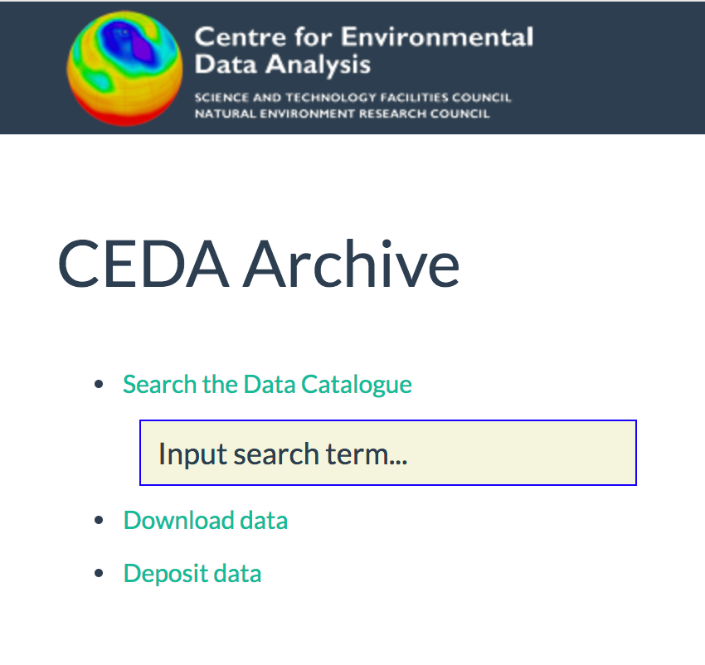
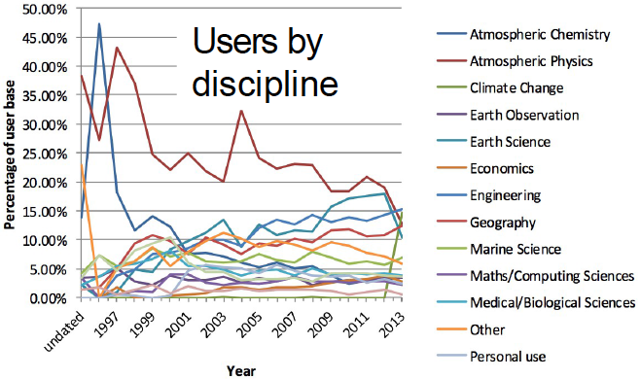
CEDA Archive (July 2018)
Data Type | Data Volume (Petabytes)
Earth Observation | 4
Atmospheric Science | 2
Total | 6PB
~ 556 datasets collections, ~5272 datasets
~ 154 million files
> 44,000 registered users
Notes:
Data volume via CEDA archive app(http://cedaarchiveapp.ceda.ac.uk/cedaarchiveapp/fileset/index/?search=%2Fbadc%2F). Search /badc for atmospheric, /neodc for EO – scroll to bottom for totals. No of files via same search.
No of registered users is from CEDAdb (http://cedadb.ceda.ac.uk/admin/udbadmin/user/?q=) – scroll to bottom for total. Some are duplicates, and its for everyone that’s registered ever. Not actually active users.
Users by discipline is harder to update. Need to find where this info came from – waiting for Victoria to come back.

Slide 14
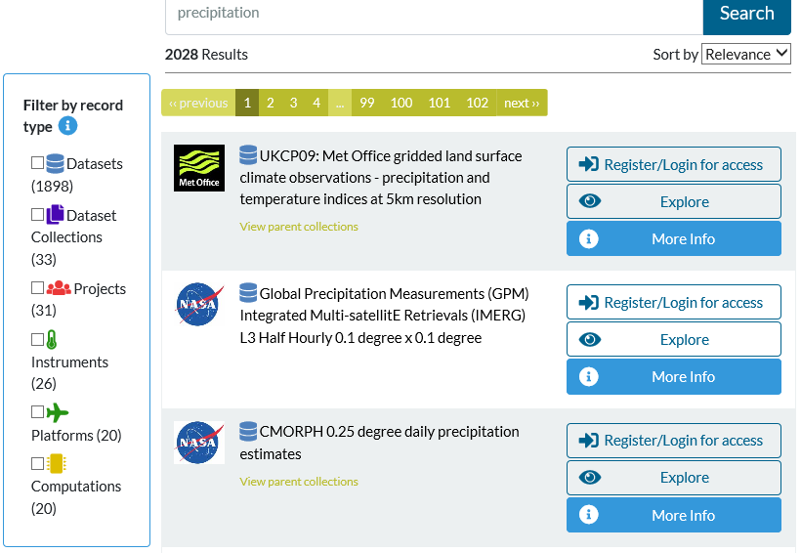
http://catalogue.ceda.ac.uk

Slide 15
What is the role of CEDA?
Preserve the science record (for data produced by NERC funded research).
Facilitate data use (for any data that compliments NERC research in Atmospheric sci or EO).
Support data standards (for international science community), e.g. ESA Climate Change Initiative; CMIP data request; Climate-Forecast (CF) metadata convention.
Engage with global community. CEDA staff participate in:
World Climate Research Programme (WCRP);
Committee on Earth Observation Satellites (CEOS);
Earth System Grid Federation (ESGF);
Intergovernmental Panel on Climate Change (IPCC) Data Distribution Centre.

Slide 16

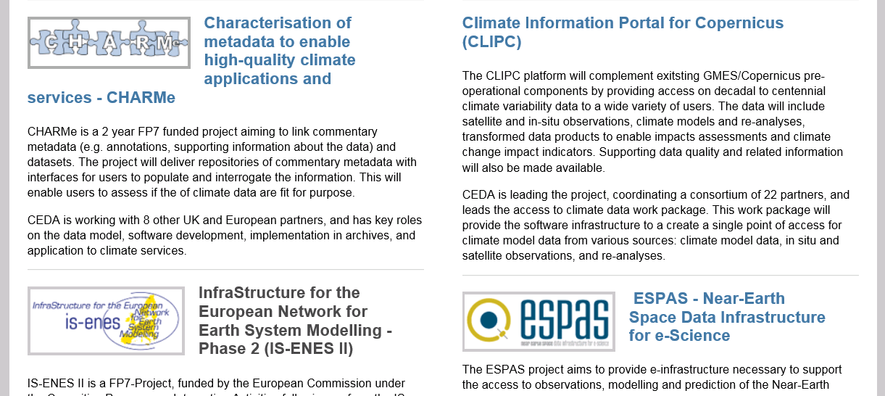
CEDA Projects
Lots more

Slide 17
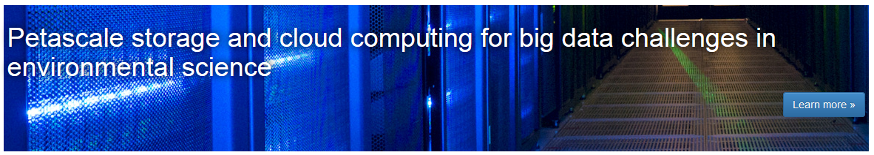
JASMIN Overview
The JASMIN facility is a "super-data-cluster" which delivers infrastructure for data analysis.
In technical terms it is half super-computer and half data-centre and it provides a globally unique computational environment.

Slide 18
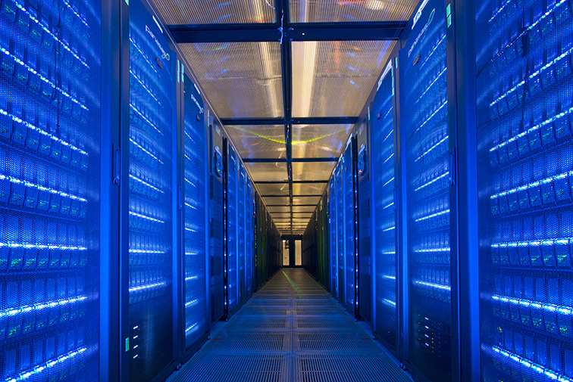
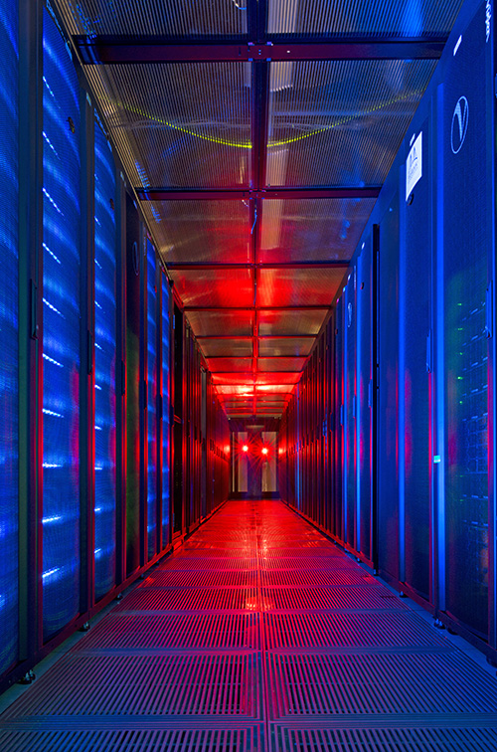
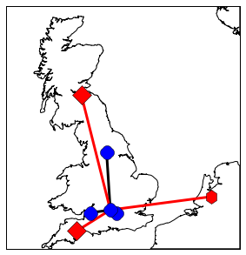
JASMIN is a world leading, unique hybrid of:
16PB high performance storage (~250GByte/s)
High-performance computing (~4,000 cores)
Non-blocking Networking (> 3Tbit/sec), and Optical Private Network WAN’s
Coupled with cloud hosting capabilities
To address “one of NERC’s most strategically important challenges: the improvement of predictive environmental science.” Prof. Duncan Wingham, NERC Chief Exec.

Slide 19















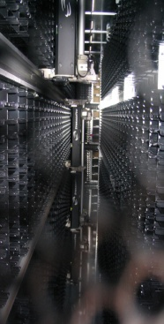
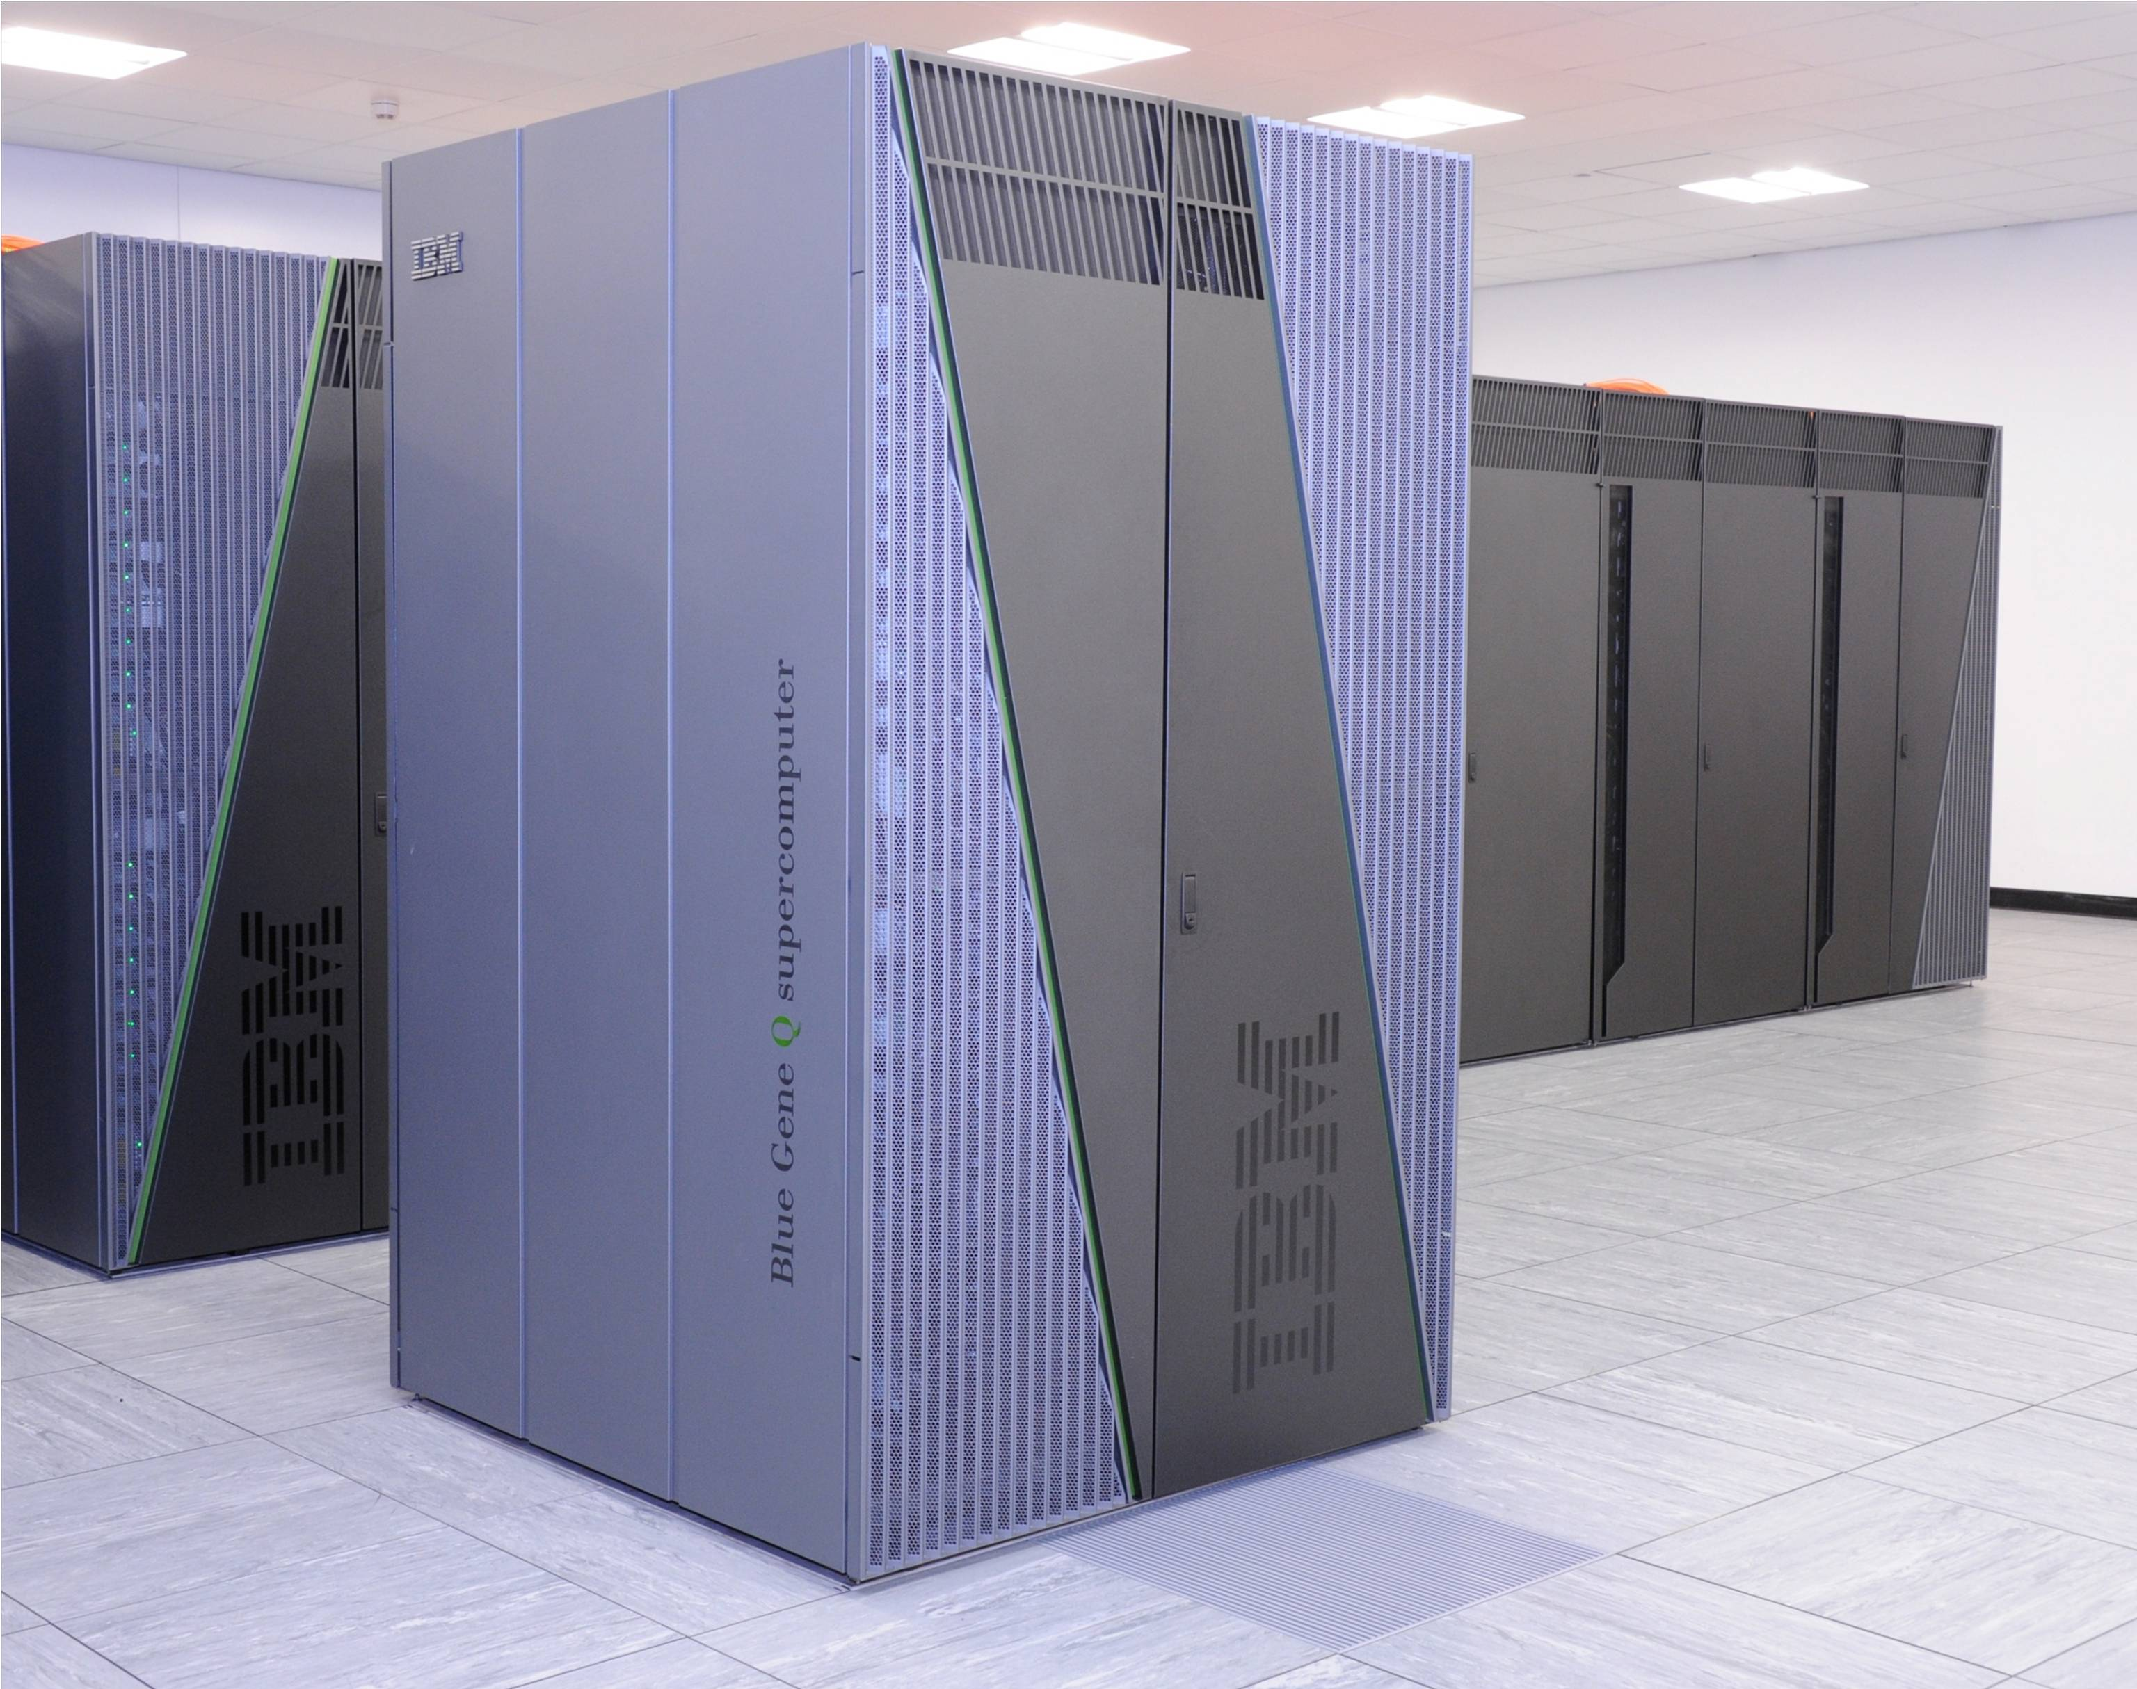
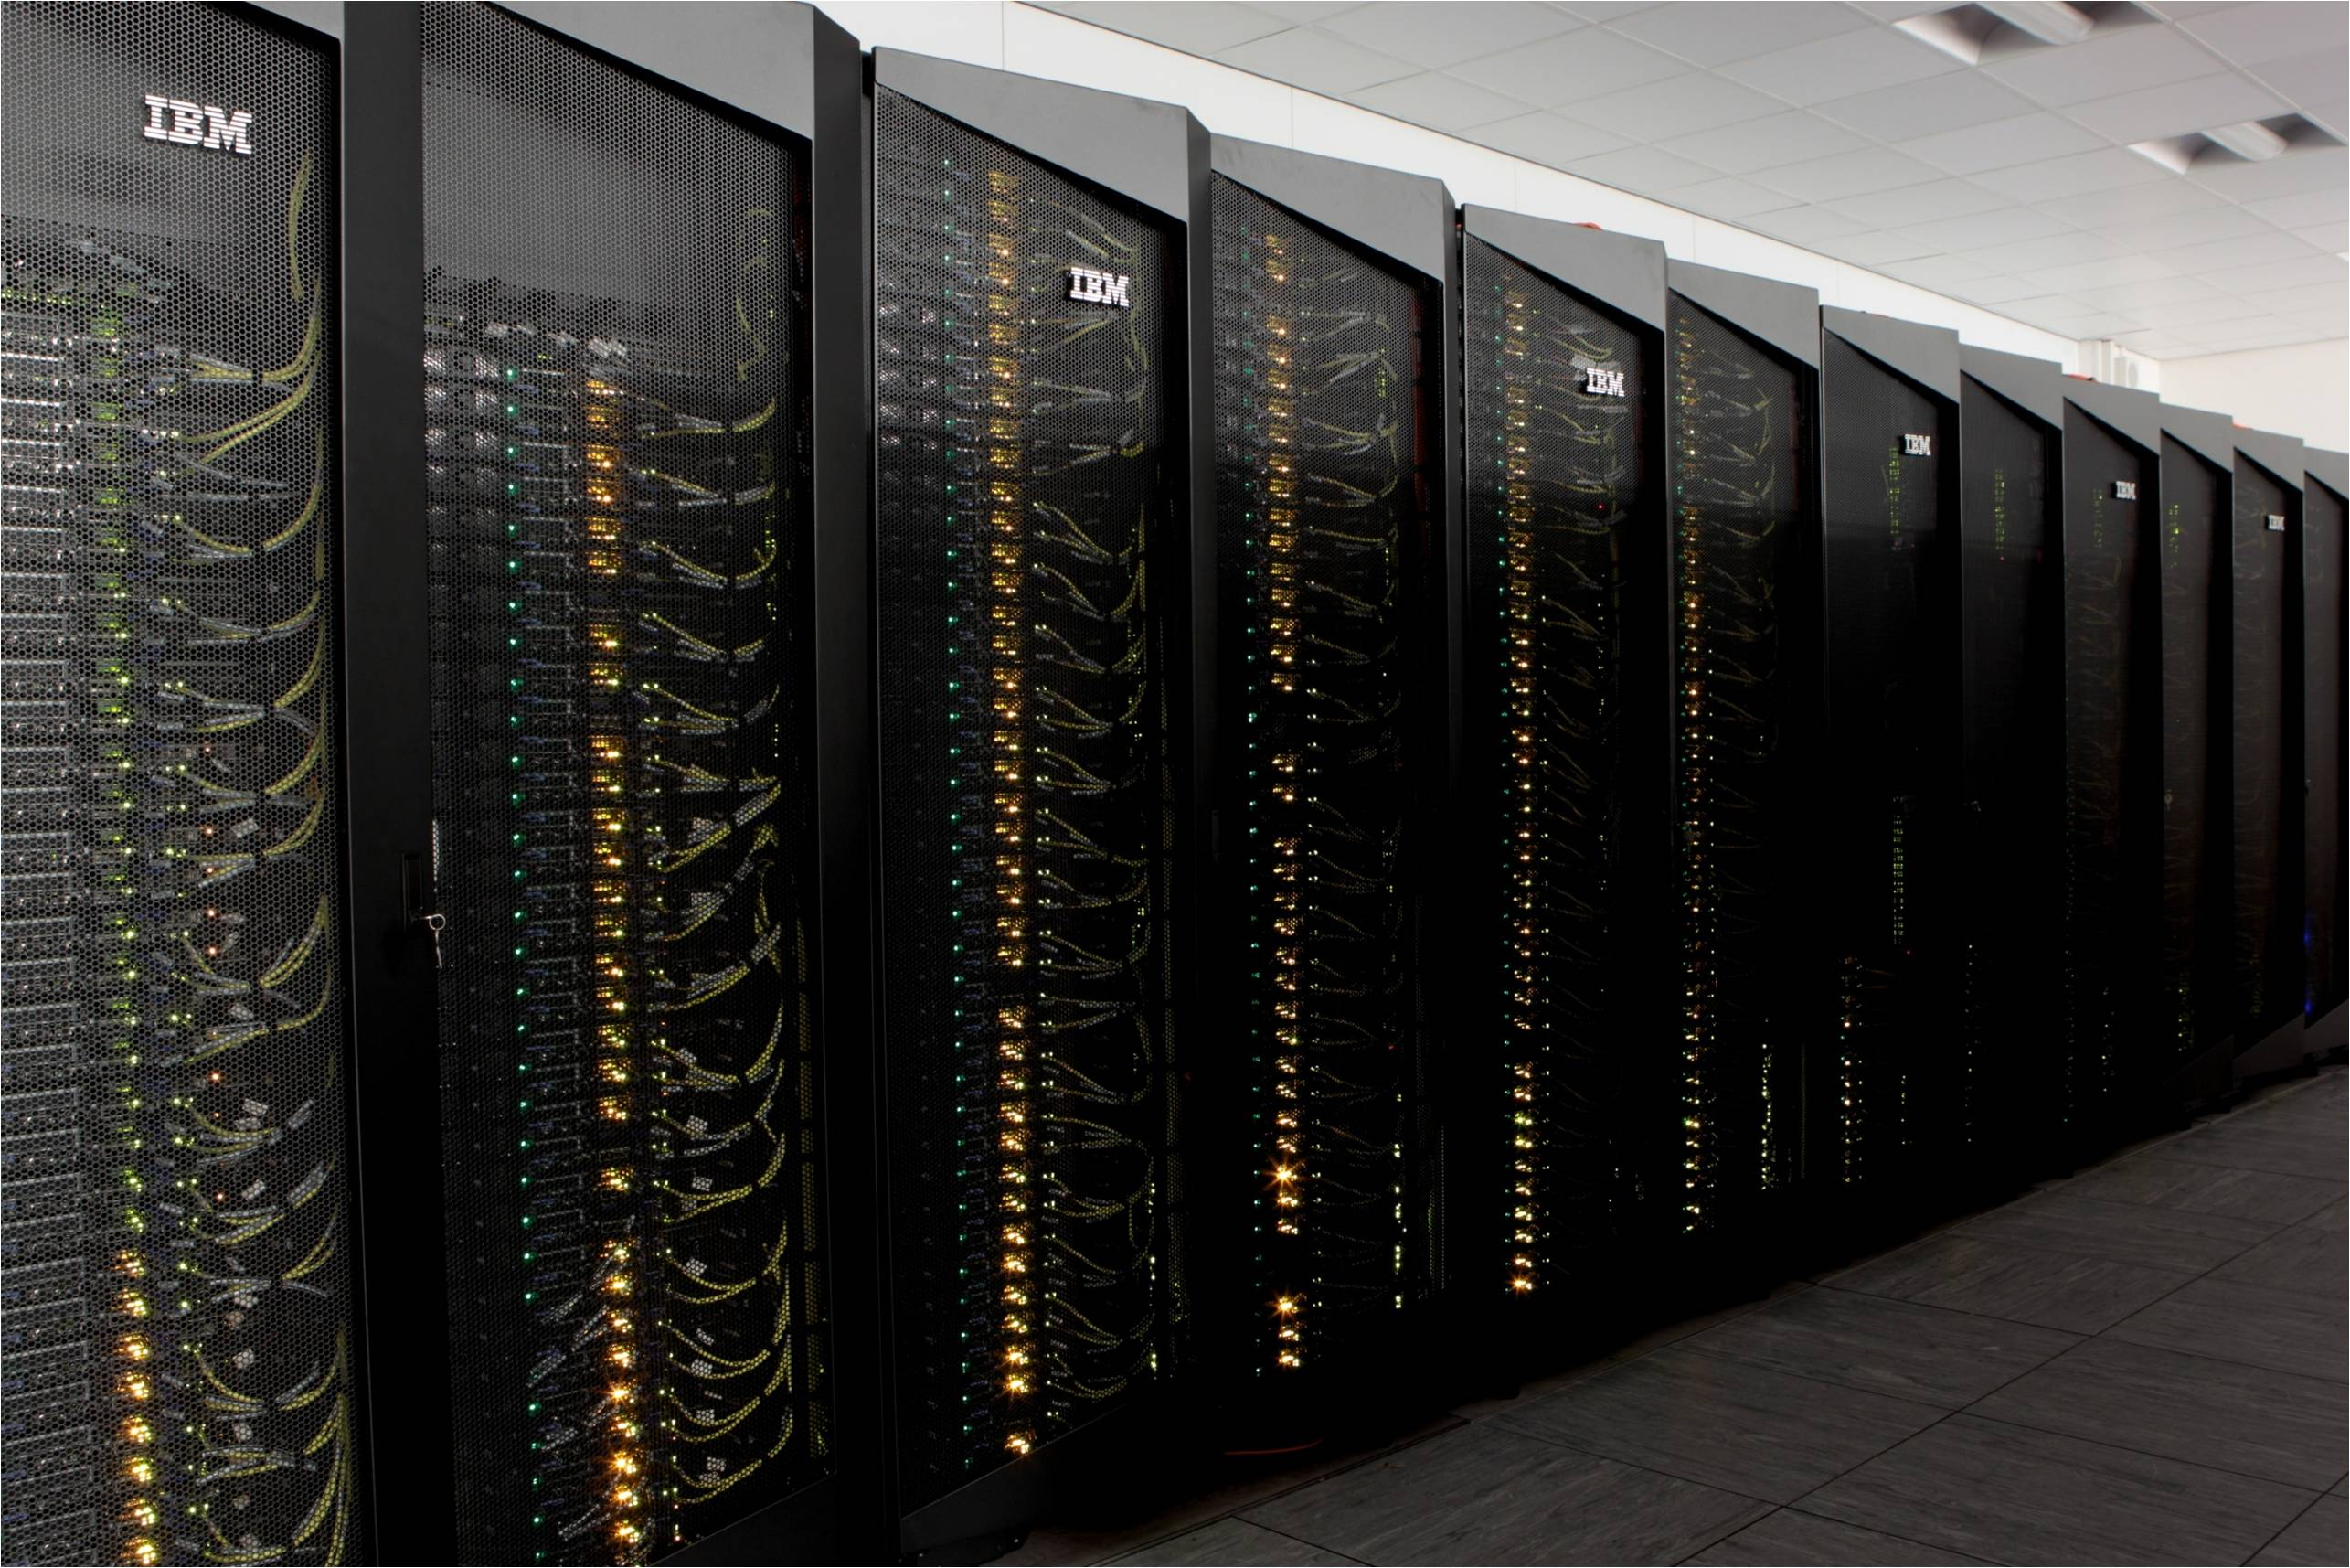
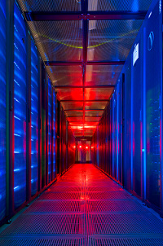











Hosted by STFC Scientific Computing Department
“Computing Expertise across length scales from processes within atoms to environmental modelling”
Applications development and support,
Compute and data facilities and services
Research and Training
Numerical Analysis
High Performance Computing
Emerald GPU cluster for Oxford, UCL, Southampton, Bristol.
SCARF HPC for RAL
Hartree: Blue Joule bluegene HPC
Hartree: Blue Wonder idataplex HPC
JASMIN: NERC super data cluster
Data Services
STFC: Facility Archives (ISIS, Diamond)
LHC: UK Hub (Tier 1 archive)
BBSRC: Institutes data archive
MRC: Data Support Service
NERC: CEDA backup and JASMIN elastic tape
Close working partnership with industry
NW-VEC
CFMS

Slide 20
Processing big data: the issues
Parallel processing in the Environmental Sciences has historically focussed on running highly-parallelised models.
Data analysis was typically run sequentially because:
It was a smaller problem
It didn’t have parallel resources available
The software/scientists were not equipped to work in parallel
The generation of enormous datasets (e.g. UPSCALE – around 300Tb) means that:
Processing big data requires a parallel approach
Fortunately, platforms, tools, and programmers are becoming better equipped
Notes:
Climate models, NWP (Numerical Weather Prediction) models, atmospheric chemistry models, ocean models, sea-ice models, and vegetation and land surface models are all examples of scientific computer code that are designed to run on parallel processing machines. They have been handled in this way since at least the 1980s. The computations required to run a complex global or regional model at high horizontal or vertical resolution could not be achieved on reasonable time-scales unless parallelisation is used. Typically the model is split into geographical regions, each processing unit on a supercomputer performs the calculations for a number of grid-points, the results are shared with neighbouring processors and then the model run continues with the next time step.
By contrast, the analysis of data (whether observed or modelled) has, until much more recently, tended to be run sequentially (i.e. one calculation at a time on a single processor). There are a number of reasons for this (listed on slide).
As supercomputer power has increased, so has the complexity of numerical models. More processing power means that a model can be run at higher resolution, say 50 km in the horizontal instead of 200 km and 100 levels in the vertical instead of 10. More physical and chemical processes can also be included because scientific understanding has improved and because the calculations can now be done on reasonable timescales. Models (especially climate models) are also run repeatedly in large ensembles to allow proper analysis of the statistical variation arising from slight differences in the model physics or starting conditions. Ensembles, higher resolution and additional numbers of calculated parameters have all served to create an explosion in recent years of the quantity of data that are being generated. These must all be stored somewhere and to be effectively analysed the task now needs a parallel approach akin to that of running the models themselves. Also, scientists are better trained in how to use parallel computing techniques to perform their analyses.

Slide 21
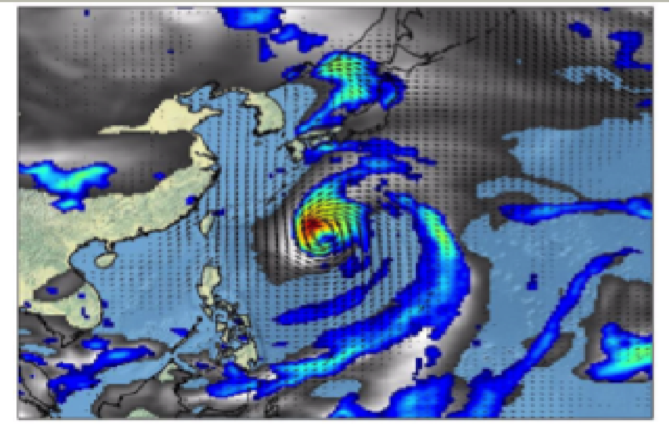
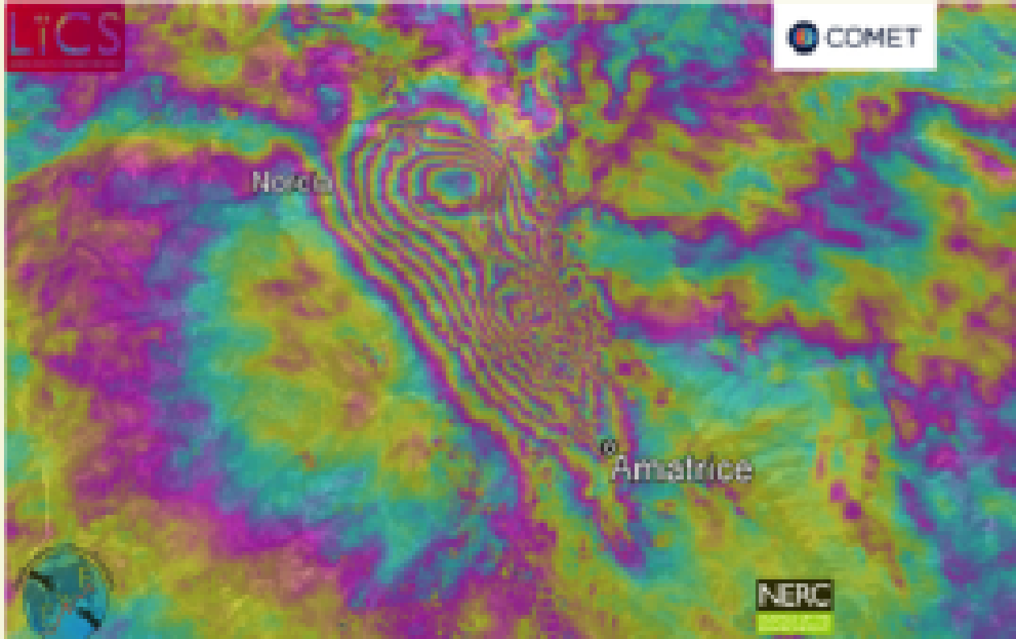
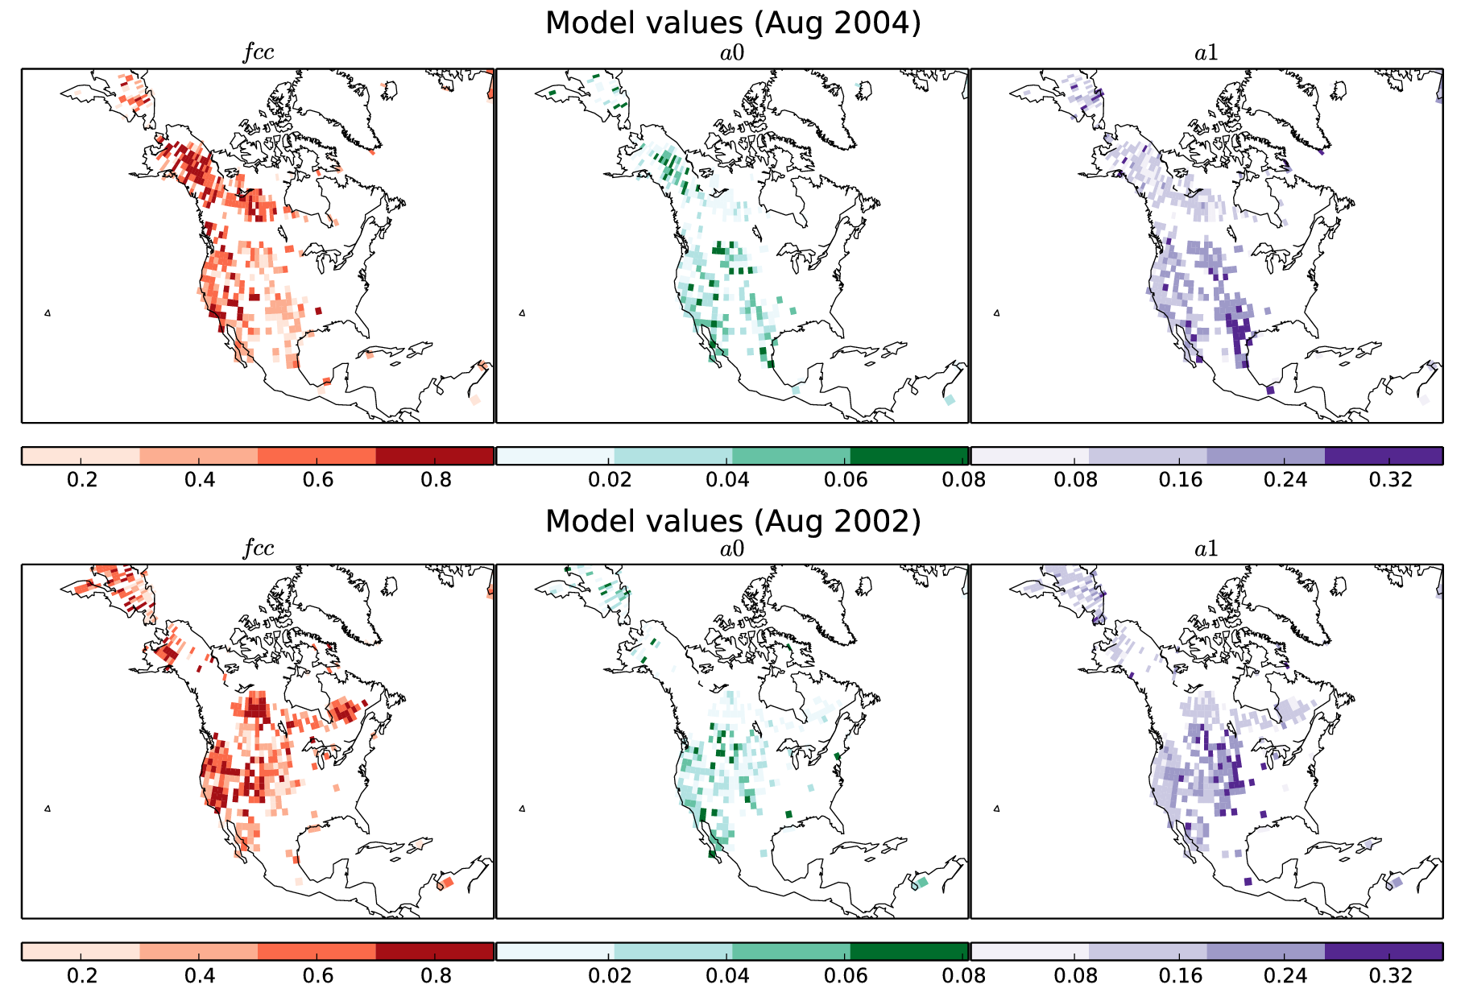
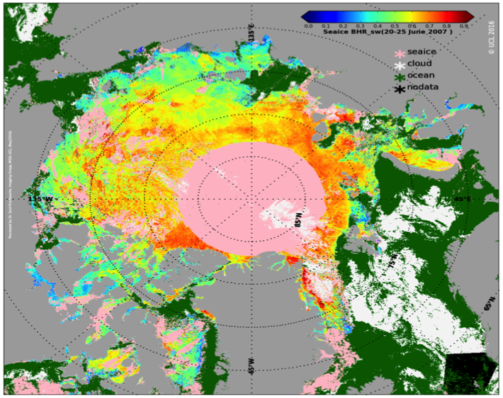
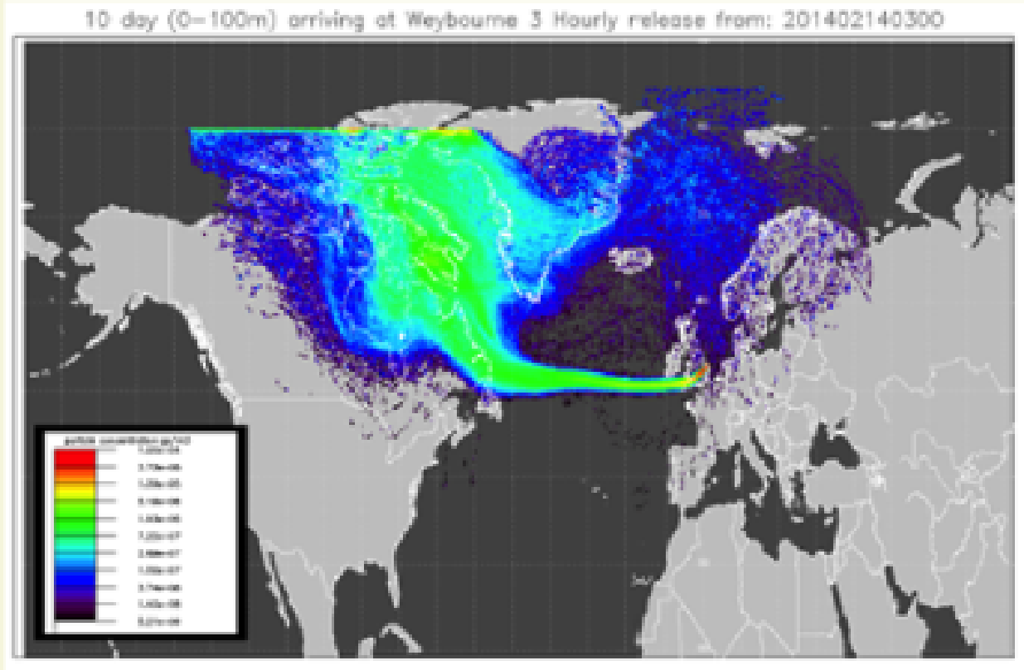
~150 Science projects on JASMIN to date
High Res Climate Model analysis
Fault analysis
Deriving the impact of fire on vegetation from earth observation data
Climate variables from European and US instruments/satellites
Atmospheric dispersion
Notes:
These analyses have a number of features:
Plotting and calculating statistics from large volumes of data, e.g. High Res climate model, such as UPSCALE, in which horizontal resolutions comparable to NWP are used;
Combining multiple variables and datasets to derive new information, e.g., diagnosing Essential Climate Variables (ECVs), or fire impacts – typically these applications require the use of date from satellite channels operating at multiple wavelengths, or overlaying data from different satellites
Atmospheric dispersion is a slightly unusual case, in that not only is the analysis carried out on JASMIN, but the model itself runs there. (Typically JASMIN is NOT for running models, but for analysing the output.
N.B. Combining data from different sources can be computationally expensive, e.g. because the data have to be regridded to be on the same resolution and coordinate system.
Even if data are from a single source, it can require a lot of memory to process, e.g. when calculating long term climate means.

Slide 22
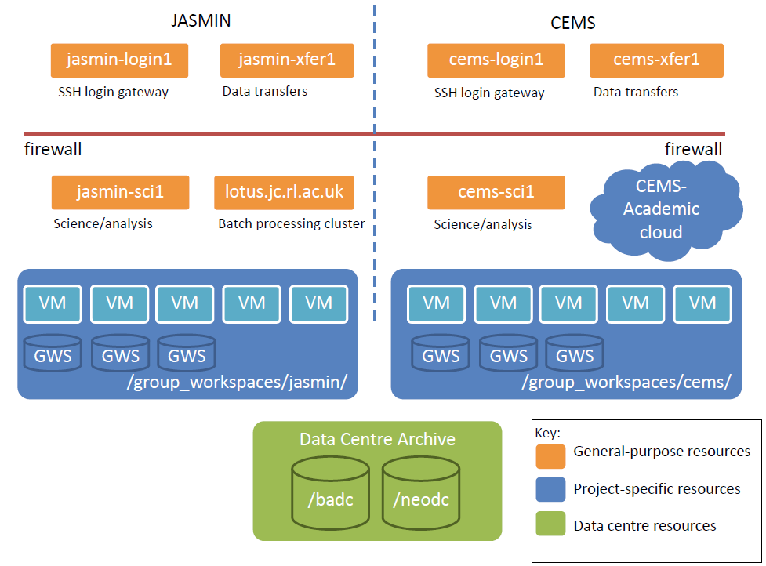
JASMIN in pictures
Notes:
Explain the following points:
* You can log in to JASMIN via the “login1” server
* You can transfer data to/from JASMIN via the “xfer1” server
* Once logged in, you can use 3 different types of computing resource:
- Generic scientific servers (“sci1/2”)
- Generic processing cluster (“lotus”) – very relevant to this presentation.
- Project-specific servers – if you are involved in the relevant project and you have signed up for access.
* Your home directory will appear across all computing resources
* But any large data storage should happen on Group Workspaces – which you need to apply for access to.

Slide 23


JASMIN Cloud Infrastructure
JASMIN Unmanaged Cloud
External Cloud Providers
MyOrganisation-JVO
CEMS-JVO-2
Science Analysis VM 0
Web App VM
Science Analysis VM 0
Data transfers
Science Analysis VM 0
Science Analysis VM 0
Database VM
Compute Cluster VM
Science Analysis VM
Users: Individuals and Organisations
GWS
GWS
firewall
JASMIN Managed Cloud
Public IP
Project1-JVO
MyProject-JVO
CEMS-JVO-1
Science Analysis VM 0
Data xfer VM
Science Analysis VM 0
Login VM
Science Analysis VM 0
Data xfer VM
Science Analysis VM 0
Science Analysis VM 0
Science Analysis VM 0
Science Analysis VM
Science Analysis VM
Science Analysis VM
GWS
GWS
GWS
lotus.jc.rl.ac.uk
Data Centre Archive
Key:
General-purpose resources
JVO - JASMIN Virtual Organisations
Data centre resources
lotus.jc.rl.ac.uk
lotus.jc.rl.ac.uk
/badc
/neodc
lotus.jc.rl.ac.uk
Batch processing cluster

Slide 24
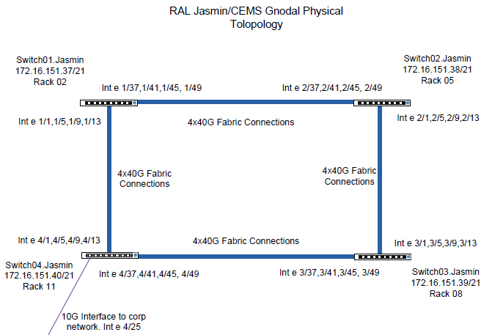
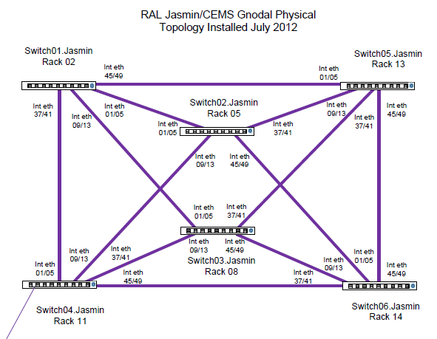
Internal network:
vital to JASMIN / CEMS performance
172.16.144.0/21 = 2,000 IPs
130.246.136.0/21
Flat Overlaid L2
160->240 Ports @ 10Gb

Slide 25
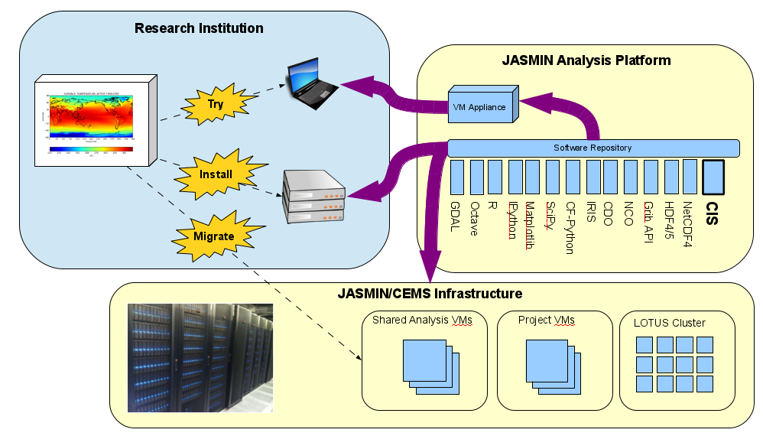
The “JASMIN Analysis Platform”: a re-usable, re-deployable bundle of common tools
These tools can be installed anywhere inside JASMIN with one or two commands!

Slide 26
Further Information
NCAS website: ncas.ac.uk
CMS website: cms.ncas.ac.uk
CEDA website: ceda.ac.uk
JASMIN website: jasmin.ac.uk

